Slide 1


Task 2 Solution
Notes:
Hello, I’m Abdelrahman Abdelwahab. I’m here to explain my code, show my results, and how I got them.

Slide 2
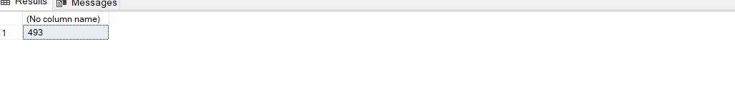
1-What is the total number of reservations in the dataset?
Notes:
In the first question we need to know the number of reservations in the dataset? I assumed that we need only to count the ones with Booking_status Not_cancelled as this the only reservation the hotel will have So the query as shown select all and with the aggregate fn count to get the shown result .

Slide 3
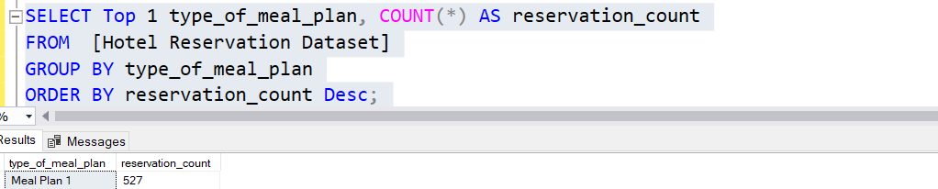
2-Which meal plan is the most popular among guests?
Notes:
In the second question we need to know which meal plan is the most popular among guests?
Here the code selects the coloumn named type_of_meal_plan and group rows by this coloumn and count each group then order in desending order and select the top 1 and here is the result

Slide 4
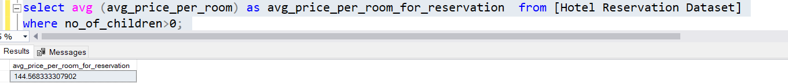
3- What is the average price per room for reservations involving children?
Notes:
In the third question we need to know What is the average price per room for reservations involving children
So I selected the coloumn of the prices and use the aggregate fn avg to get the average and use where clause to get only the one with the no_children > 0

Slide 5
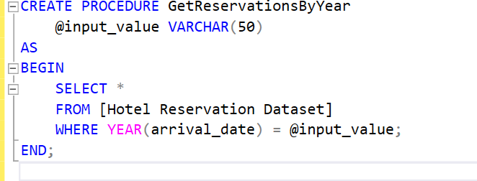
4-How many reservations were made for the year 20XX (replace XX with the desired year)?
Notes:
In the foruth question we need to know How many reservations were made for the year 20XX these xx can be replace by any value so we made a procedure as shown so we change the xx to any desired val as it is not const for certain year once we run that procedure we are able to use it again and pass any year we need as shown in the second image and the result is the shown table

Slide 6
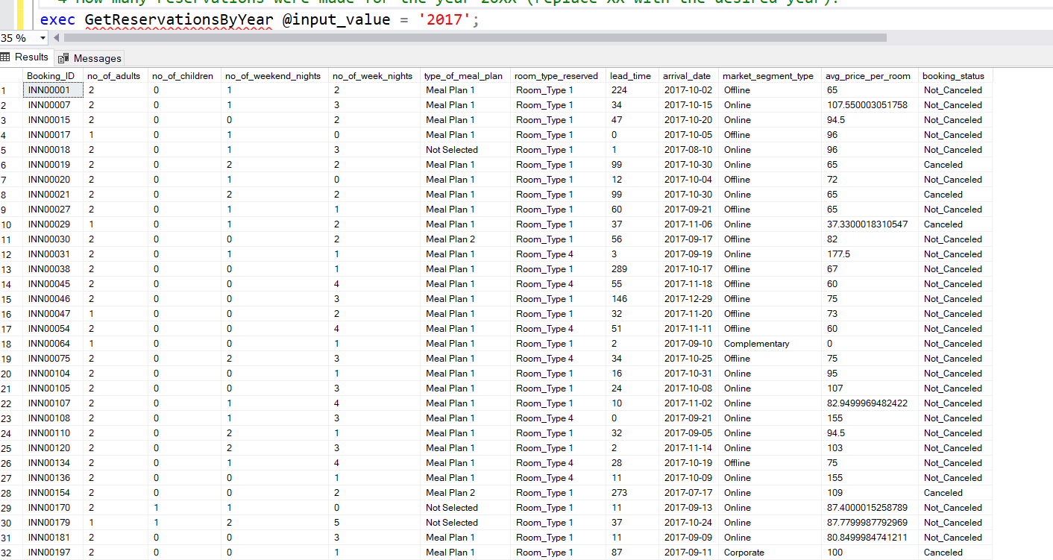
4-How many reservations were made for the year 20XX (replace XX with the desired year)?
Notes:
In the foruth question we need to know 4-How many reservations were made for the year 20XX these xx can be replace by any value so I made a procedure as shown so we can apply chage to the xx to any desired val as it is not const for certain year once we run that procedure we are able to use it again and pass any year we need as shown in the second image and the result is the shown table

Slide 7
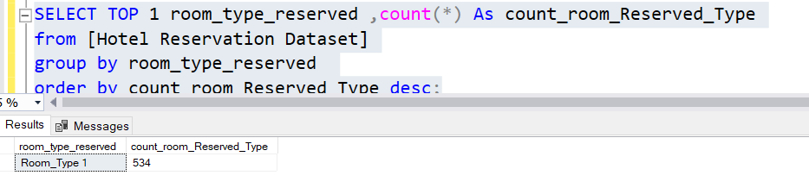
5- What is the most commonly booked room type?
Notes:
In the fifth question we need to know What is the most commonly booked room type?
The solution is like question 2 we select the desired column and group by room type then count each group and arrange them in desecding order and choose the top1

Slide 8
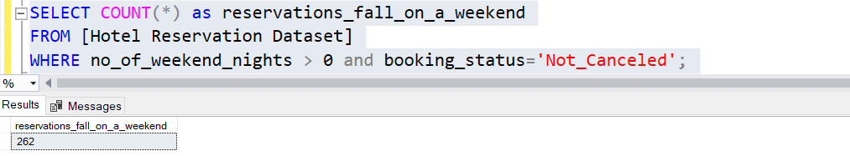
6-How many reservations fall on a weekend (no_of_weekend_nights > 0)? assume that the cancelled reservation is not considered
Notes:
In the sixth question we need to know How many reservations fall on a weekend which means (no_of_weekend_nights greater than 0)? assume that the cancelled reservation is not considered
So the query as shown select all and count rows where the no_of_weekend_nights > 0 and booking status not cancelled

Slide 9
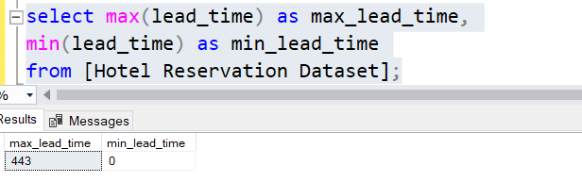
7-What is the highest and lowest lead time for reservations?
Notes:
In the seventh question we need to know What is the highest and lowest lead time for reservations? So we used the min and max functions as shown the min lead time zero means that the arrival date is the same as the reservation date so no lead_time

Slide 10
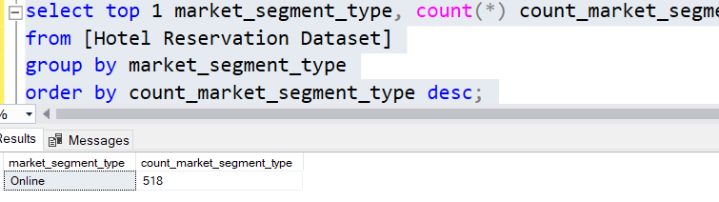
8-What is the most common market segment type for reservations?
Notes:
In the eightht question we need to know What is the most common market segment type for reservations? So idea as q 2 and q 5 select , group , count , order descending and choose the top 1

Slide 11
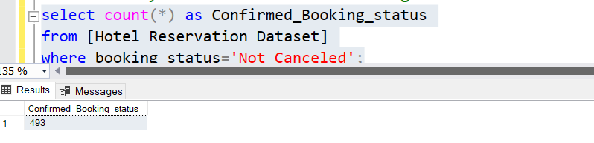
9- How many reservations have a booking status of "Confirmed"?
Notes:
In the ninth question How many reservations have a booking status of "Confirmed"? I didn’t understand that question well I don’t know if It means by confirmed the not cancelled ones
Or it needs the one with leadtime 0 or the arrival time means when the customer will arrive or when the duration start this question really confuses me as each case will have some modifications I solved it as the not canceled is considered to be confirmed till now

Slide 12
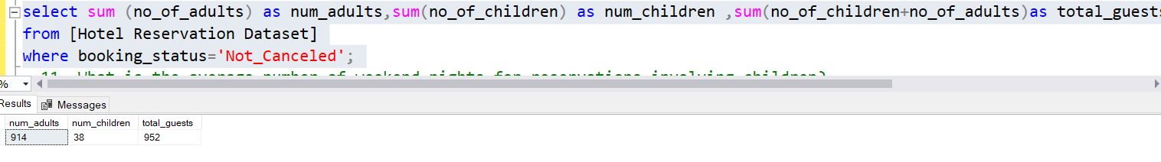
10-What is the total number of adults and children across all reservations? assume the not cancelled reservation is only required
Notes:
In the tenth question What is the total number of adults and children across all reservations? assume the not cancelled reservation is only required so I summed the no_of_children and no_of_adults and summed theses as total guests as shown

Slide 13
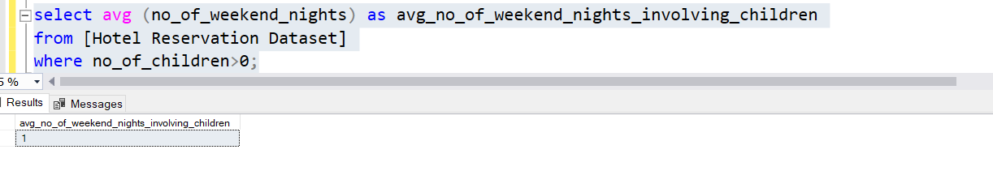
11- What is the average number of weekend nights for reservations involving children?
Notes:
In the eleventh question we need to know What is the average number of weekend nights for reservations involving children? So I select the no_of_weekend_nights and use the avg fn on it and used the whrere clause no_of_children > 0

Slide 14
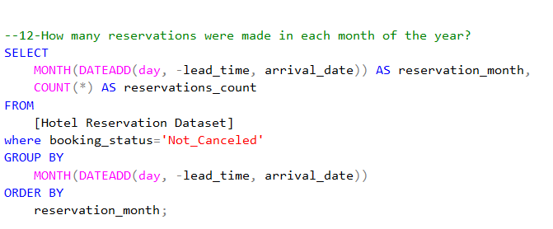
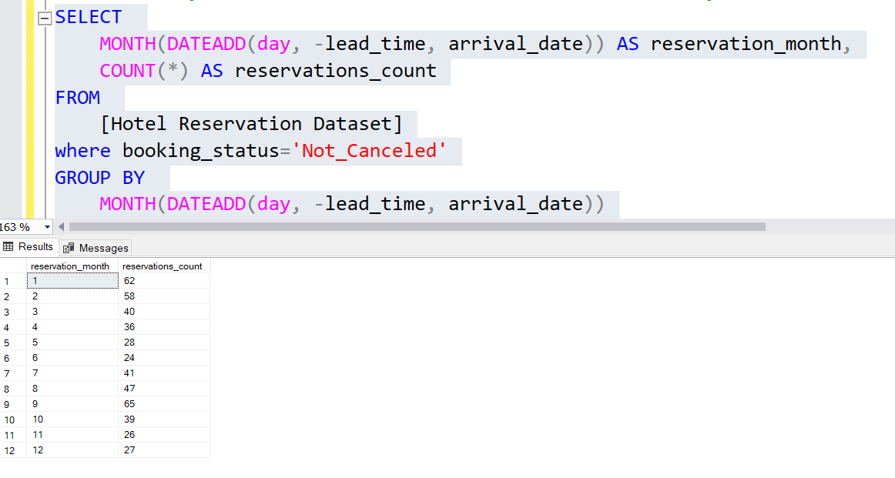
12-How many reservations were made in each month of the year?
Notes:
In the twelevth question we need to know How many reservations were made in each month of the year?
I use the dateAdd which is a function that adds or subtracts a specified time interval to a date.
The first argument, day, specifies that the time interval to be added or subtracted is in days
The second argument, -lead_time, specifies the number of days to subtract from arrival_date. The minus sign indicates subtraction.
The third argument, arrival_date, is the starting date from which the days will be subtracted.
Then The MONTH function extracts the month part from a given date then I group same months together and count them as shown in the result
Then, months order by in their known order

Slide 15
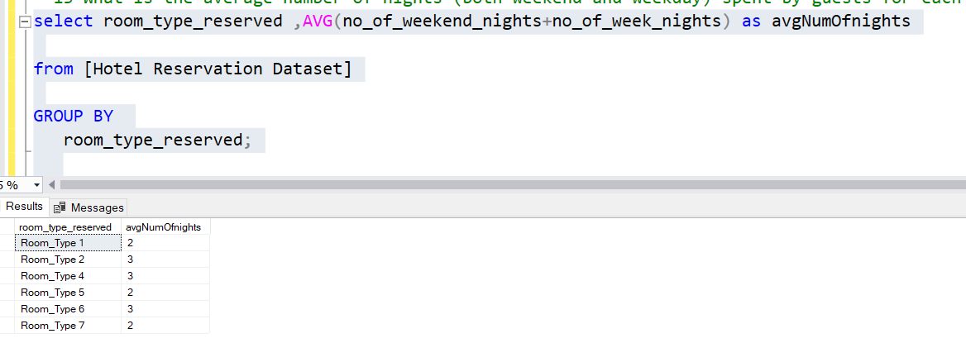
13-What is the average number of nights (both weekend and weekday) spent by guests for each roomtype?
Notes:
In the thirteenth question we need to know What is the average number of nights (both weekend and weekday) spent by guests for each roomtype?
So I summed no_of_weekend_nights and no_of_week_nights then got the avg for them and group according to the room_reservation_type

Slide 16
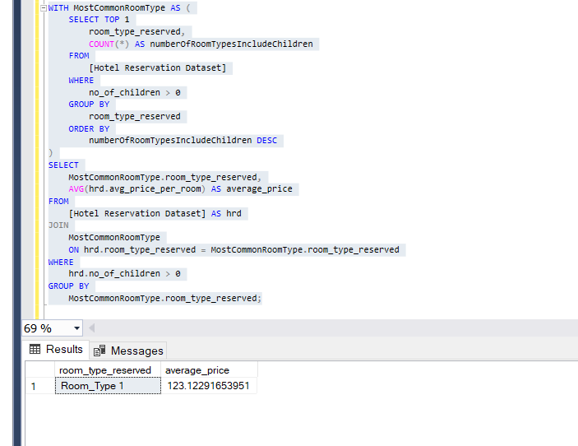
14- For reservations involving children, what is the most common room type, and what is the average price for that room type?
Notes:
In the fourteenth question we need to know For reservations involving children, what is the most common room type, and what is the average price for that room type? So I used with as to make as temporarily columns from the original one including the most common room type involving children then do another query selecting the avg price then
Join these tables according to the condition hrd.typereserved=MostCommonRoomType.room_type_reserved hrd is the abbreviation of Hotel Reservation Dataset and get the result as shown

Slide 17
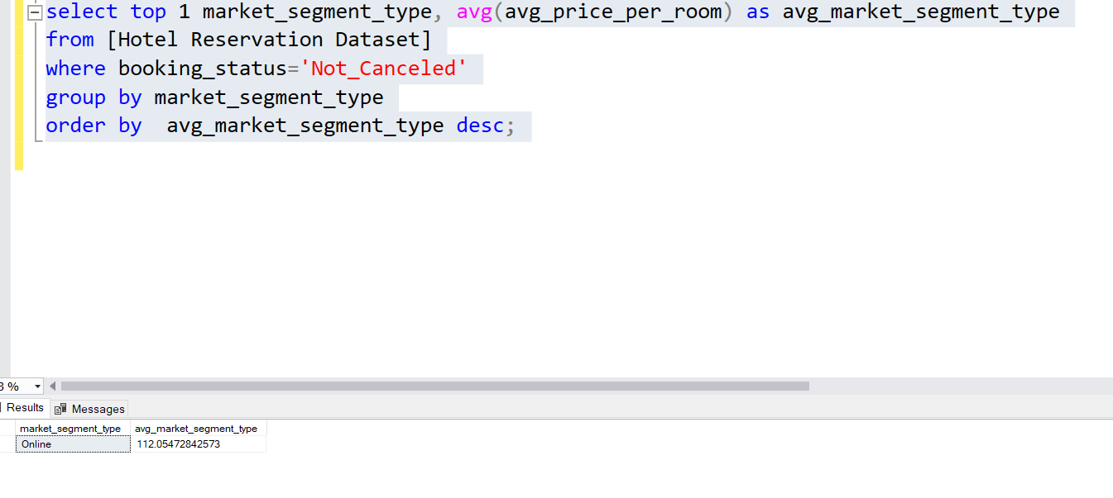
15-Find the market segment type that generates the highest average price per room.
Notes:
In the fifthenth question, it’s required to know market segment type that generates the highest average price per room so also as 2 Q and 5 Q select , group , count , order descending and choose the top 1

